Slide 1
Applied Capstone Project – Analysing the effect of COVID 19
By Ishaan Arya

Slide 2

Introduction
Corona Virus or COVID 19 is a disease which causes more severe disease than seasonal influenza. While many people globally have built up immunity to seasonal flu strains, COVID-19 is a new virus to which no one has immunity. That means more people are susceptible to infection, and some will suffer severe disease. Globally, about 3.4% of reported COVID-19 cases have died. By comparison, seasonal flu generally kills far fewer than 1% of those infected.

Slide 3
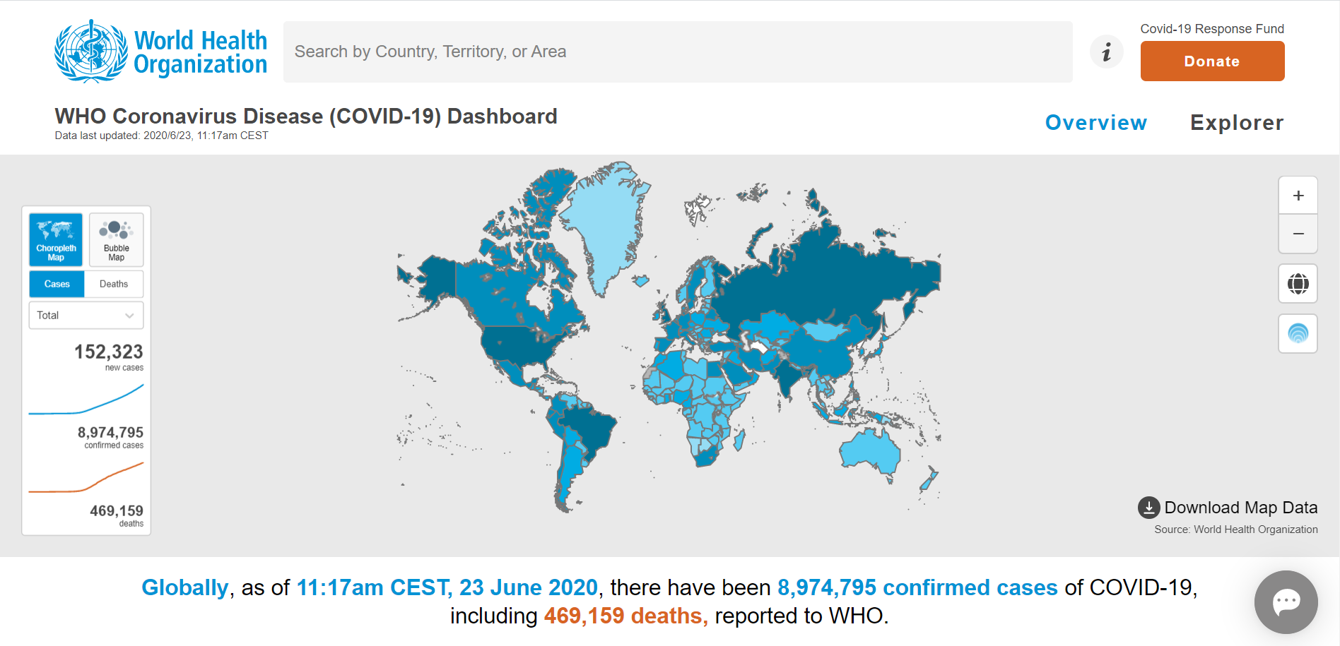
Data Science for COVID 19
Data Science has helped us a lot during the COVID 19 pandemic.
There are several dashboards made which are referred by people all across the globe. These dashboards are constantly giving us information about this crisis, proving how valuable data analytics is.
SOURCE : World Health Organisation

Slide 4
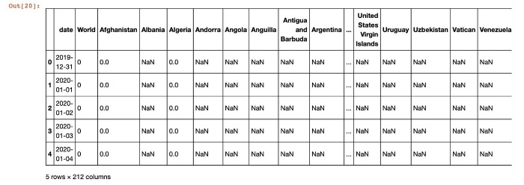
Data Description 1
Data 1 :
The primary data which is to be used for this analysis would be the number of COVID cases in different countries on different dates. This will help us to see, for e.g. How COVID cases in different parts of the world have changed overtime.
This data is available online for free at : ps://covid.ourworldindata.org/data/ecdc/total_cases.csv

Slide 5
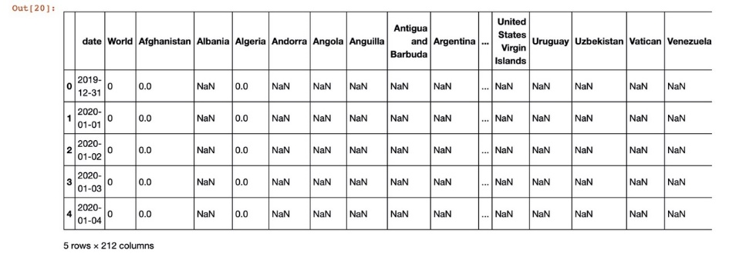
Data Description 2
Data 2 :
We would also use the data for the total number of deaths which were caused by the coronavirus in different countries overtime to find trends and perform an analysis.
This data is available online for free at : https://covid.ourworldindata.org/data/ecdc/total_cases.csv

Slide 6
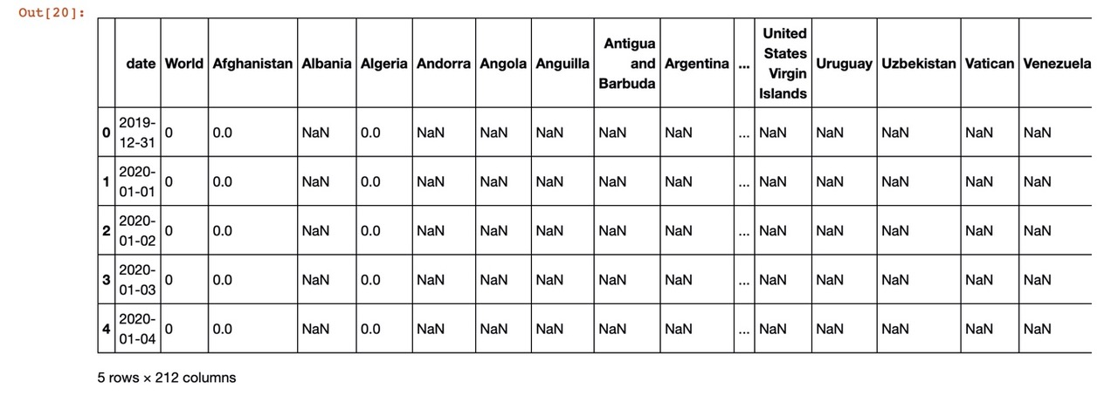
Data Description 3
https://covid.ourworldindata.org/data/ecdc/new_cases.csv
Data 3 :
We would also use the data for new COVID cases as this will help us to for e.g. observe how the daily growth in COVID cases has changed overtime.
This data is available online for free at : https://covid.ourworldindata.org/data/ecdc/total_cases.csv

Slide 7
Data Description 4
Data 4 :
We would also use the data for new COVID deaths as this will help us to for e.g. observe how the daily growth in COVID deaths have changed overtime.
This data is available online for free at : https://covid.ourworldindata.org/data/ecdc/new_deaths.csv

Slide 8
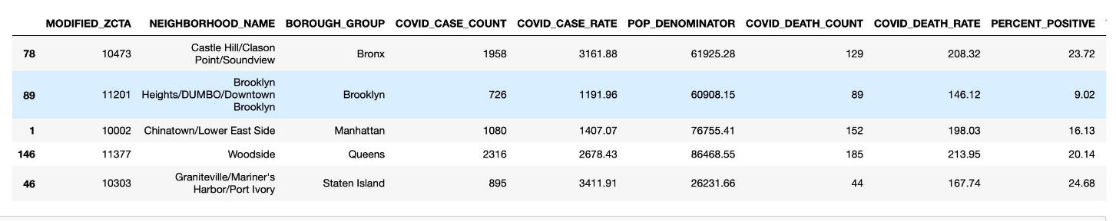
Data Description 5
Data 5 :
Lastly, data from New York was also used in my analysis in order to explore a particular area and compare how COVID has impacted different neighbourhoods in the city of New York.
This data is available online for free at : https://raw.githubusercontent.com/nychealth/coronavirus-data/master/data-by-modzcta.csv

Slide 9
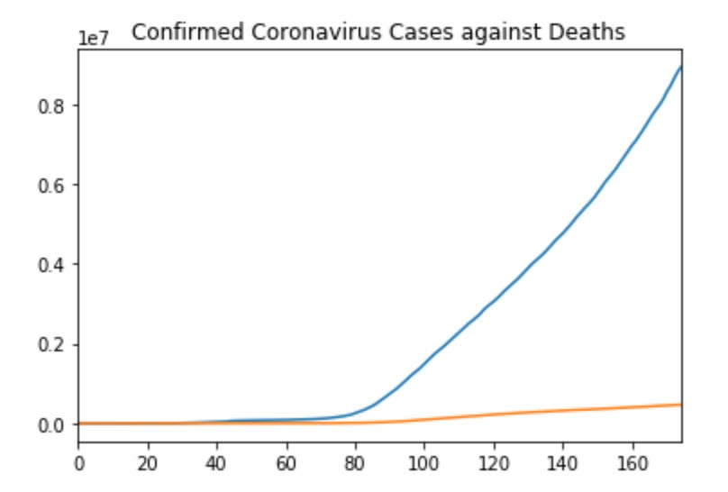
Exploratory Data Analysis 1
- TOTAL GLOBAL CASES
- TOTAL GLOBAL DEATHS

Slide 10
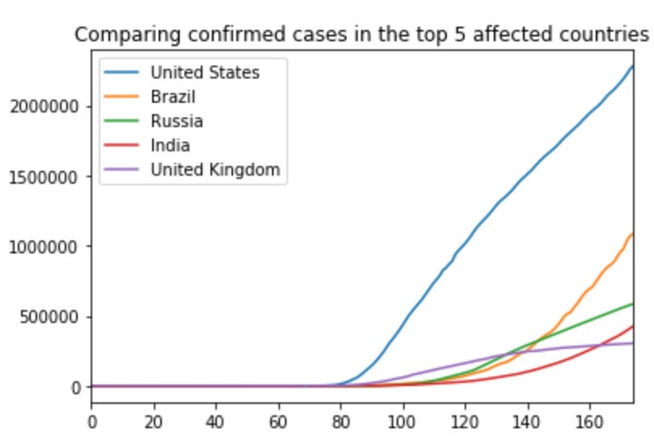
Exploratory Data Analysis 2
CONSTANTLY HIGH
MAJOR SUDDEN RISE
STEADY GROWTH
STEADILY INCREASING CASES
“FLATTENING THE CURVE”

Slide 11
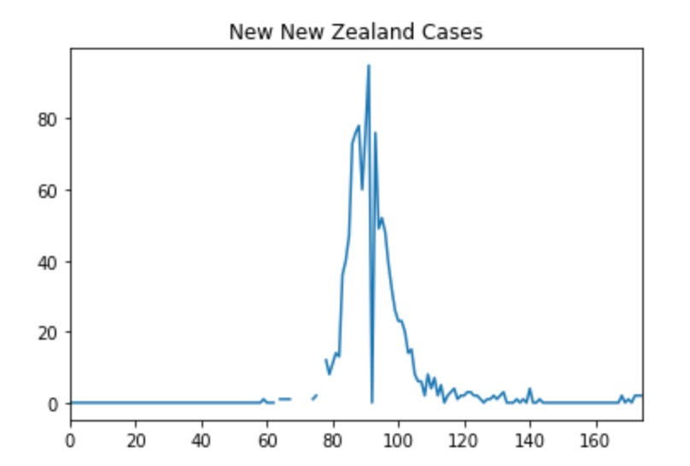
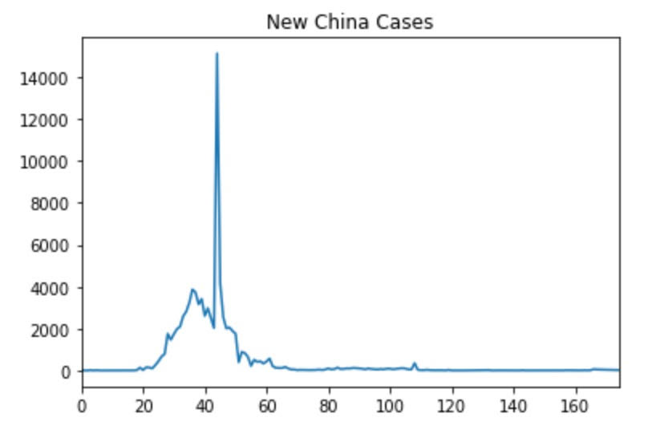
Exploratory Data Analysis 3
Countries which have successfully controlled the Corona Virus
CURRENT CASES CLOSE TO 0
CURRENT CASES
CLOSE TO 0

Slide 12
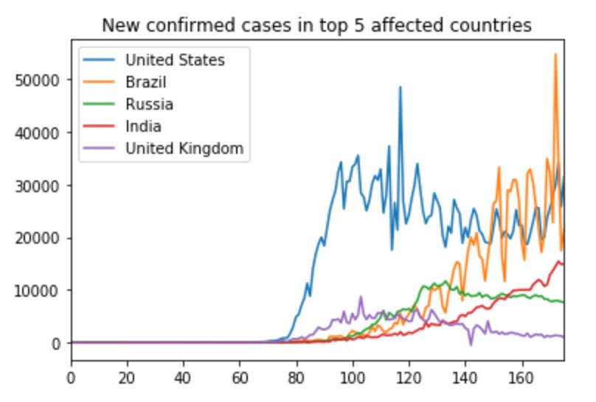
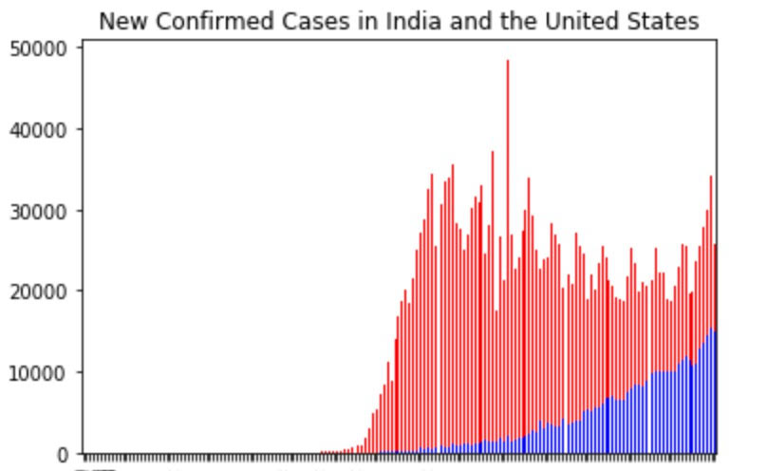
Exploratory Data Analysis 4
STEADILY INCREASING CASES, SIMMILAR TO A LOGARITHMIC FUNCTION
UNPREDICTALE GROWTH; LARGE NUMBER OF NEW CASES
STEADILY INCREASING CASES
CURRENT CASES CLOSE TO 0
CURRENT CASES CLOSE TO 0
NEAR 0 NEW CASES (FLATTENING THE CURVE)

Slide 13
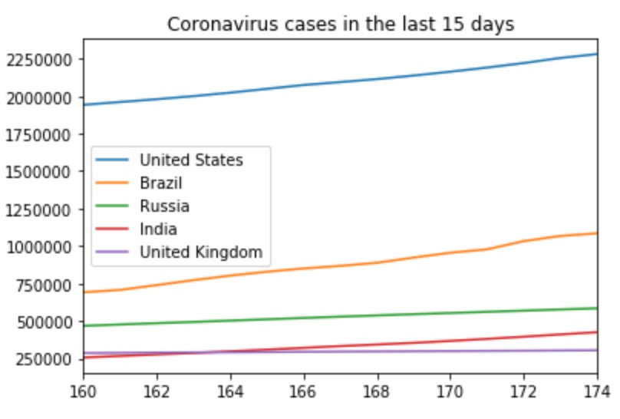
Exploratory Data Analysis 5

Slide 14
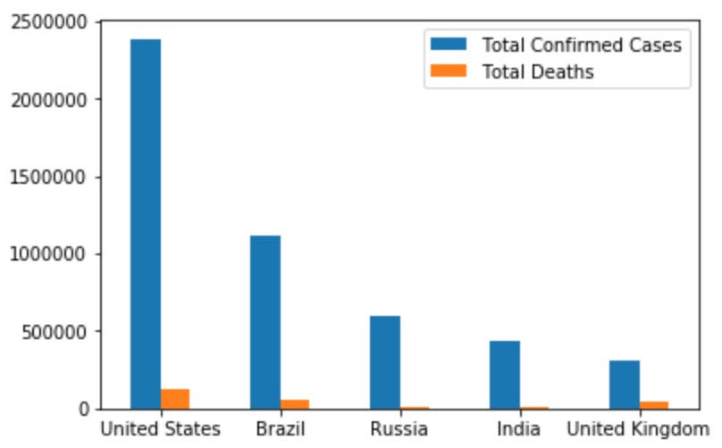
Exploratory Data Analysis 6
Depicts Low Mortality Rate

Slide 15
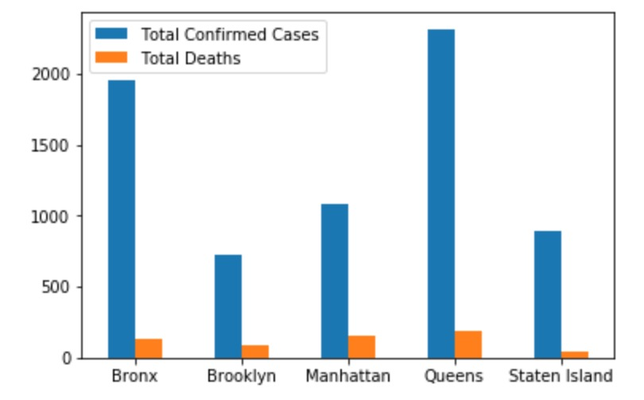
Exploratory Data Analysis 7
Coronavirus in different parts of New York City

Slide 16
DISCUSSION
1. Lockdowns have helped in some countries like the UK while they have not proven beneficial in countries like India and the United States.
2. The mortality rate of the coronavirus is very low as few people are dying, governments could open the economy for people who are at less risk.
3. More healthcare resources should be devoted to Queens and Bronx as they have reported the greatest number of cases among places in New York City.

Slide 17
CONCLUSIONS
The effects of Coronavirus can clearly be seen in my analysis. It can be discerned that:
1. The United States has shown a large increase in the number of cases. It has recorded the most cases in the world and the lockdown hasn’t helped control the situation.
2. Russia and the United Kingdom have done well in controlling the coronavirus. The number of daily cases has decreased in both countries and they are reporting less new cases every day and are “flattening the curve”.
3. India and Brazil have a rapid growth of Covid cases. The imposition of the lockdown hasn’t helped India as it still has a trend of increasing cases similar to a logarithmic function.
4. Countries like New Zealand and China have done very well in combating the coronavirus and can be ideals for other countries.
5. In New York, Bronx and Queens have reported the most Coronavirus cases.

